Slide 1

Data Science Capstone Course Presentation

Slide 2
Project analysis slide 2
Project Analysis
INTRODUCTION
DATA ACQUIRING & CLEANING
PROJECT
METHODOLOGY
RESULTS
DISCUSSION
CONCLUSION

Slide 3
Project analysis slide 3
Introduction
Background : Safety is a new concern when moving to a new area. If you don’t feel in your own home, you are not going to enjoy living there.
Problem : This project aims to select the fastest borough in London based on the total crimes, explore the neighborhoods of that borough to find the 10 most common venues in each venues and finally cluster the neighborhood and finally cluster the neighborhood using k-mean clustering.
Interest : Expats who are considering to relocate to London will be interested to identify the safest borough in London and explore its neighborhoods and common venues around each neighborhood.

Slide 4
Project analysis slide 4
Data Acquisition
First Source
Uses London Crime data that shows the crime per borough in London.
Second Source
Wikipedia page that contains the list of London borough with additional information about borough.
Third Source
List of neighborhoods in Royal Borough of Kingston upon Thames from Wikipedia page.

Slide 5
Project analysis slide 5
Data Cleaning
Data Cleaning: Done separately for all three resources.
From the London crime data, the crime during the most recent year (2019) are only selected. The major categories of crime are pivoted to get the total crimes per the boroughs for each major category.
The second data is scraped from Wikipedia page using the Beautiful Soup library in python. Using this library, we can extract the data in the tabular format as shown in figure.
Two datasets are merged on Borough names to form a new dataset. The purpose of this dataset is to visualize the crime rates in each borough and identify the borough with the least crimes recorded during the year 2016.
After visualizing the crime in each borough we can find the borough with the lowest crime rate. The third dataset is created with the names of neighborhood and the name of the borough with the longitude and latitude obtained from Google API geocoding.

Slide 6
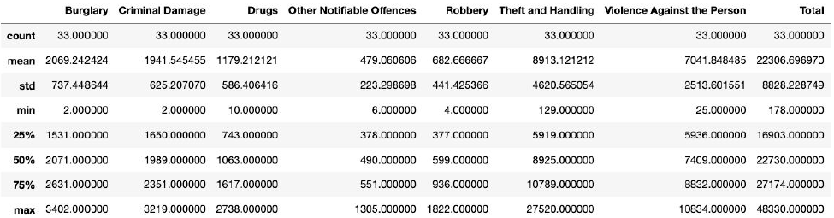
Project analysis slide 6
Methodology
Exploratory Data Analysis
The count of the major categories of crime return the value 33 which is the number of London Boroughs. ‘Theft and Handling’ is the highest reported crime during the year 2016 followed by ‘Violence against the person’, ‘Criminal Damage’. The lowest recorded crimes are ‘Drugs’, ‘Robbery’ and ‘Other Notifiable Offences’.

Slide 7
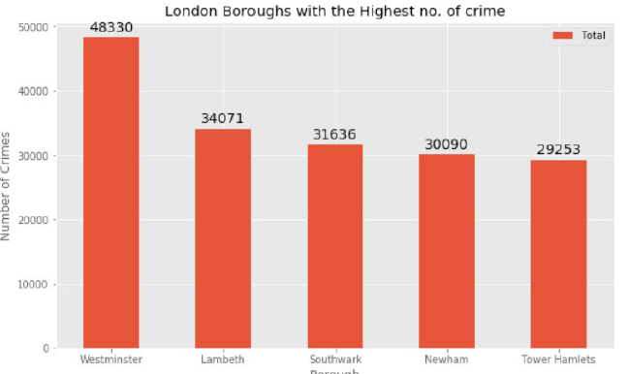
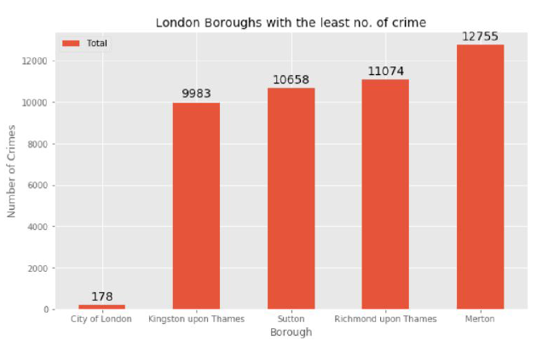
Project analysis slide 7
Methodology (Cont.)

Slide 8
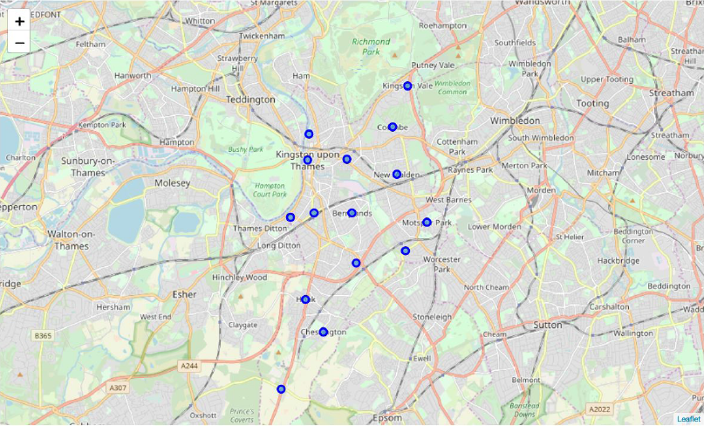
Project analysis slide 8
Methodology (Cont.)
There are 15 neighborhoods in the Royal borough of Kingston upon Thames. They can be visualized on the map using Folium.

Slide 9
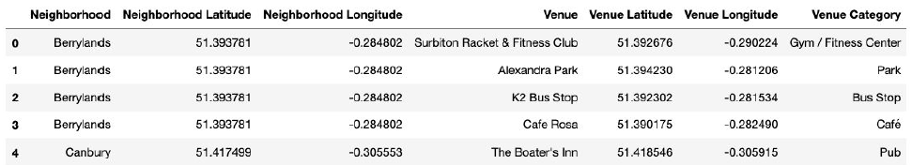
Project analysis slide 10
Methodology (Model)
Using the final dataset containing the neighborhoods in Kingston upon Thames along with the latitude and longitude, we can find all the venues within a 500 meter radius of each neighborhood by connecting to the Foursquare API. This returns a json file containing all the venues in each neighborhood which is converted to a pandas dataframe. This data frame contains all the venues along with their coordinates and category.
One hot encoding is done on the venues data. (One hot encoding is a process by which categorical variables are converted into a form that could be provided to ML algorithms to do a better job in prediction). The Venues data is then grouped by the Neighborhood and the mean of the venues are calculated, finally the 10 common venues are calculated for each of the neighborhoods.
To help people find similar neighborhoods in the safest borough we will be clustering similar neighborhoods using K - means clustering which is a form of unsupervised machine learning algorithm that clusters data based on predefined cluster size. We will use a cluster size of 5 for this project that will cluster the 15 neighborhoods into 5 clusters. The reason to conduct a K- means clustering is to cluster neighborhoods with similar venues together so that people can shortlist the area of their interests based on the venues/amenities around each neighborhood.

Slide 10
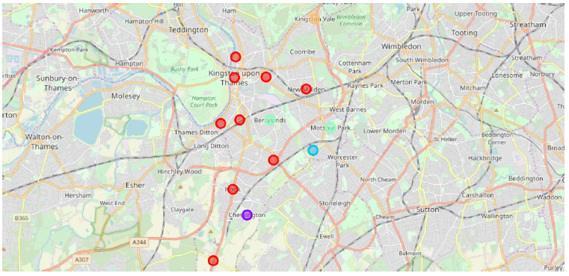
Project analysis slide 10
Results
After running K-means clustering we can see each cluster created to see each cluster which neighborhood assigned to each of the 5 clusters.
Each cluster is coded for ease of presentation, most of the clusters are in red colors. Three neighborhood have their own color (Blue, Purple, Yellow). The green cluster has 2 neighborhoods.

Slide 11
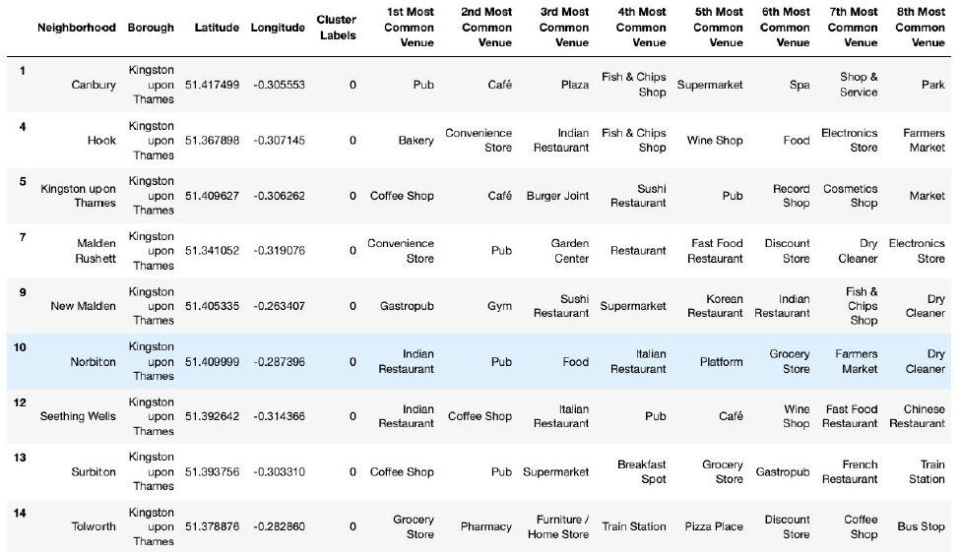
Project analysis slide 10
Results (Cont.)
Cluster 1

Slide 12
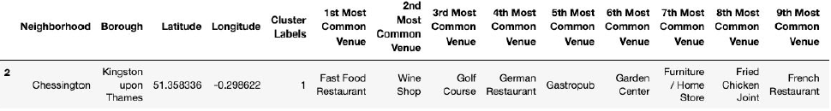
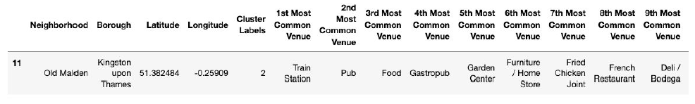
Project analysis slide 10
Results (Cont.)
Cluster 2
Cluster 2
Cluster 3

Slide 13
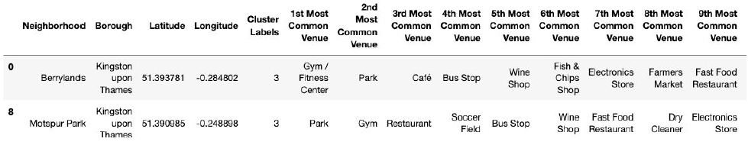
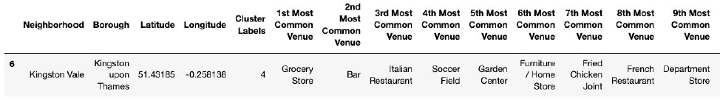
Project analysis slide 10
Results (Cont.)
Cluster 4
Cluster 5

Slide 14
Project analysis slide 10
Discussion
The aim of this project is to help people who want to relocate to the safest borough in London, expats can chose the neighborhoods to which they want to relocate based on the most common venues in it.
For example if a person is looking for a neighborhood with good connectivity and public transportation we can see that Clusters 3 and 4 have Train stations and Bus stops as the most common venues.
If a person is looking for a neighborhood with stores and restaurants in a close proximity then the neighborhoods in the first cluster is suitable.
For a family I feel that the neighborhoods in Cluster 4 are more suitable dues to the common venues in that cluster, these neighborhoods have common venues such as Parks, Gym/Fitness centers, Bus Stops, Restaurants, Electronics Stores and Soccer fields which is ideal for a family. The choices of neighborhoods may vary from person to person.

Slide 15
Project analysis slide 10
Conclusion
This project helps a person get a better understanding of the neighborhoods with respect to the most common venues in that neighborhood. It is always helpful to make use of technology to stay one step ahead i.e. finding out more about places before moving into a neighborhood.
We have just taken safety as a primary concern to shortlist the safest borough of London. The future of this project includes taking other factors such as cost of living in the areas into consideration to shortlist the borough, such as filtering areas based on a predefined budget.

Slide 16
Thank You

